Slide 1
System Development Methodology

Slide 2
System Development Methodology
Systems development methodology (SDM) is a standard process followed in an organization to conduct all the steps necessary to analyze, design, implement system.
It is highly beneficial for organizations to adopt a systems development methodology to develop system.

Slide 3
Software Development Life Cycle (SDLC)
In systems engineering, information systems and software engineering, the systems development life cycle (SDLC), also referred to as the application development life-cycle, is a process for planning, creating, testing, and deploying an information system.
The systems development life cycle concept applies to a range of hardware and software configurations, as a system can be composed of hardware only, software only, or a combination of both.

Slide 4
SDLC
There are usually six stages in this cycle:
requirement analysis,
design, development and testing,
implementation,
documentation,
evaluation.

Slide 5
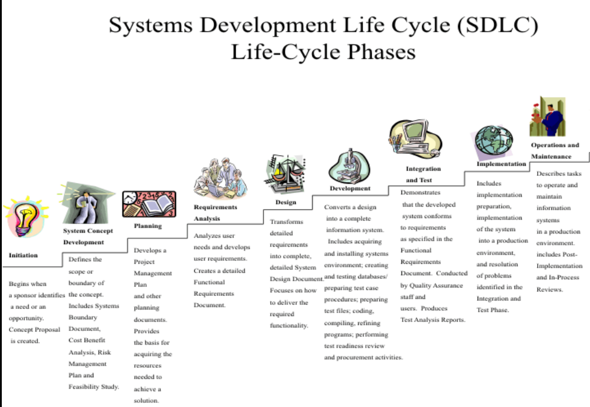
SDLC Steps

Slide 6
SDLC reasons……
Here, are prime reasons why SDLC is important for developing a software system.
It offers a basis for project planning, scheduling, and estimating
Provides a framework for a standard set of activities and deliverables
It is a mechanism for project tracking and control
Increases visibility of project planning to all involved stakeholders of the development process
Increased and enhance development speed
Improved client relations
Helps you to decrease project risk and project management plan overhead

Slide 7
Waterfall Design
The waterfall model is a breakdown of project activities into linear sequential phases, meaning they are passed down onto each other, where each phase depends on the deliverables of the previous one and corresponds to a specialization of tasks.
The approach is typical for certain areas of engineering design. In software development, it tends to be among the less iterative and flexible approaches, as progress flows in largely one direction ("downwards" like a waterfall)

Slide 8
Waterfall Design
Process:
Initiation
Analysis
design
construction
Testing
deployment and maintenance

Slide 9
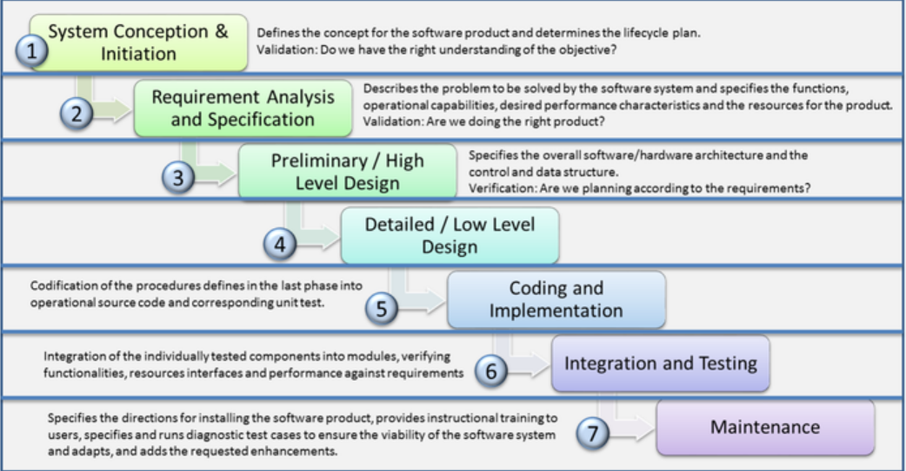
Waterfall Design

Slide 10
When Waterfall Need…..
Waterfall Methodology can be used when:
Requirements are not changing frequently
Application is not complicated and big
Project is short
Requirement is clear
Environment is stable
Technology and tools used are not dynamic and is stable
Resources are available and trained

Slide 11
Rapid Application Development (RAD)
Rapid Application Development or RAD means an adaptive software development model based on prototyping and quick feedback with less emphasis on specific planning.
In general, the RAD approach prioritizes development and building a prototype, rather than planning.
With rapid application development, developers can quickly make multiple iterations and updates to the software without starting from scratch.
This helps ensure that the final outcome is more quality-focused and aligns with the end users’ requirements.

Slide 12
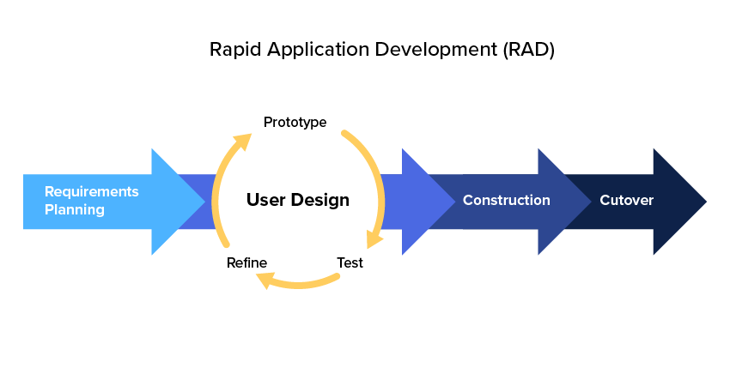
RAD

Slide 13
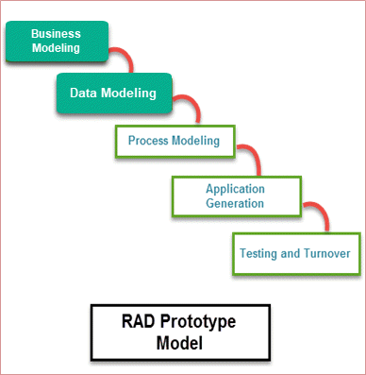
RAD

Slide 14
RAD
When to use RAD Methodology?
When a system needs to be produced in a short span of time (2-3 months)
When the requirements are known
When the user will be involved all through the life cycle
When technical risk is less
When there is a necessity to create a system that can be modularized in 2-3 months of time
When a budget is high enough to afford designers for modeling along with the cost of automated tools for code generation

Slide 15
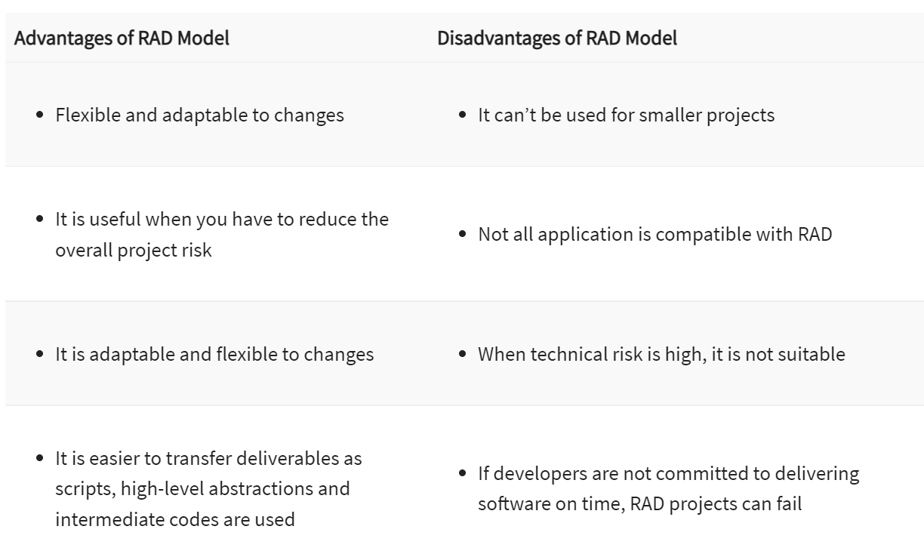
RAD

Slide 16
Extreme Programming (XP)
Extreme Programming (XP) is an agile software development framework that aims to produce higher quality software, and higher quality of life for the development team.
Extreme programming (XP) is one of the most important software development frameworks of Agile models.
It is used to improve software quality and responsiveness to customer requirements.

Slide 17
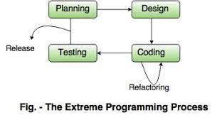
Extreme Programming

Slide 18
Extreme Programming
Applications of Extreme Programming (XP): Some of the projects that are suitable to develop using the XP model are given below:
Small projects: XP model is very useful in small projects consisting of small teams as the face-to-face meeting is easier to achieve.
Projects involving new technology or Research projects: This type of project face changing requirements rapidly and technical problems. So XP model is used to complete this type of project.

Slide 19
Agile Methodology
The Agile software development methodology is one of the simplest and effective processes to turn a vision for a business need into software solutions.
Agile is a term used to describe software development approaches that employ continual planning, learning, improvement, team collaboration, evolutionary development, and early delivery. It encourages flexible responses to change.

Slide 20
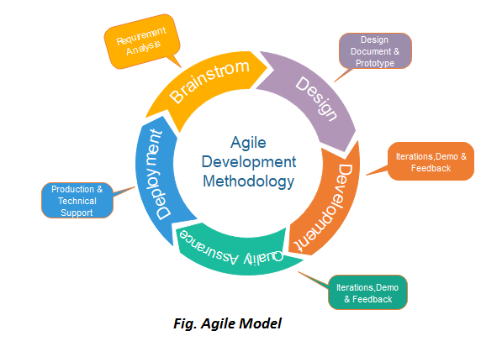

Slide 21
Agile Methodology
The agile software development emphasizes on four core values.
Individual and team interactions over processes and tools
Working software over comprehensive documentation
Customer collaboration over contract negotiation
Responding to change over following a plan

